Slide 1
Parsing V: Bottom-up Parsing
Lecture 10
CS 4318/5531 Spring 2009
Apan Qasem
Texas State University
*some slides adopted from Cooper and Torczon

Slide 2
Parsing Techniques
Top-down parsers (LL(1), recursive descent)
Start at the root of the parse tree and grow toward leaves
Pick a production & try to match the input
Bad “pick” ⇒ may need to backtrack
Some grammars are backtrack-free (predictive parsing)
Bottom-up parsers (LR(1), operator precedence)
Start at the leaves and grow toward root
As input is consumed, encode possibilities in an internal state
Bottom-up parsers handle a large class of grammars
Automatic parser generators such as yacc generate bottom-up parsers

Slide 3
Parsing Definitions : Recap
The point of parsing is to construct a derivation
A derivation consists of a series of rewrite steps
S ⇒ γ₀ ⇒ γ₁ ⇒ γ₂ ⇒ … ⇒ γ_{n–1} ⇒ γ_{n} ⇒ sentence
Each γ_{i} is a sentential form
  If γ contains only terminal symbols, γ is a sentence in L(G)
  If γ contains ≥ 1 non-terminals, γ is a sentential form
To get γ_{i} from γ_{i–1}, expand some NT A ∈ γ_{i–1} by using A →β
  Replace the occurrence of A ∈ γ_{i–1} with β to get γ_{i}
  In a leftmost derivation, it would be the first NT A ∈ γ_{i–1}

Slide 4
Bottom-up Parsing
A bottom-up parser builds a derivation by working from the input sentence back toward the start symbol S
S ⇒ γ₀ ⇒ γ₁ ⇒ γ₂ ⇒ … ⇒ γ_{n–1} ⇒ γ_{n} ⇒ sentence
To reduce γ_{i} to γ_{i–1} match some rhs β with a substring in γ_{i} then replace β with its corresponding lhs, A.

Slide 5
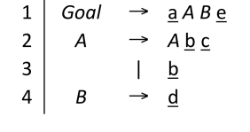
Bottom-up Parsing : Example
Input : abbcde
Build the parse tree in reverse
Create leaf nodes for terminals
in the input stream
a
b
b
c
d
e

Slide 6
Bottom-up Parsing : Example
Input : abbcde
Build the parse tree in reverse
Create leaf nodes for terminals
Leaf nodes make up the
initial frontier
Expand the frontier at
every step
a
b
b
c
d
e

Slide 7
Bottom-up Parsing : Example
Input : abbcde
Scan from left to right
Try to match part (or whole)
of the frontier with the rhs
of a production rule
Look for exact matches
a
b
b
c
d
e
left to right

Slide 8
Bottom-up Parsing : Example
Input : abbcde
Applied rule 3
Terminal b is an exact
match for the rhs of rule 3
A
a
b
b
c
d
e
left to right

Slide 9
Bottom-up Parsing : Example
Input : abbcde
Applied rule 3
Terminal b is an exact
match for the rhs of rule 3
Frontier has changed
A
a
b
b
c
d
e
left to right

Slide 10
Bottom-up Parsing : Example
Input : abbcde
Applied rule 3
Terminal b is an exact
match for the rhs of rule 3
Frontier has changed
A
a
b
b
c
d
e
left to right

Slide 11
Bottom-up Parsing : Example
Input : abbcde
A
Abc matches rhs of rule 2
Apply rule 2 to reduce
Abc to A
Could we have applied
rule 3 again to replace the
second b in the input stream?
How do we decide?
How many symbols do we need to look at?
A
a
b
b
c
d
e
left to right

Slide 12
Bottom-up Parsing : Example
Input : abbcde
A
B
Apply rule 4 to reduce d to B
A
a
b
b
c
d
e
left to right

Slide 13
Bottom-up Parsing : Example
Goal
Input : abbcde
A
B
aABe matches rhs of rule 1
Goal symbol is the root of the tree
Consumed all input
Accept string!
A
a
b
b
c
d
e

Slide 14
Bottom-up Parsing : Example
Goal
Input : abbcde
A
B
What kind of derivation did we apply?
Reverse the process and look at which non-terminal is expanded first
A
a
b
b
c
d
e

Slide 15
Bottom-up Parsing : Example
Goal
Input : abbcde
Reverse the process:
Start with Goal symbol at the root

Slide 16
Bottom-up Parsing : Example
Goal
Input : abbcde
A
B
Apply rule 1
a
e

Slide 17
Bottom-up Parsing : Example
Goal
Input : abbcde
A
B
Apply rule 4
a
d
e

Slide 18
Bottom-up Parsing : Example
Goal
Input : abbcde
A
B
Apply rule 2
A
a
b
c
d
e

Slide 19
Bottom-up Parsing : Example
1
Goal
Input : abbcde
3
2
A
B
What kind of derivation did we apply?
Rightmost derivation in reverse
4
A
a
b
b
c
d
e

Slide 20
Bottom-up Parsing Algorithm
Repeat
  Examine the frontier from left to right
  Find a substring beta in the frontier such that
    There is a production in the grammar of the form A -> β
    A -> β occurs as one step in a rightmost derivation of the sentence
  Replace β with A
    Make A the parent of each node that make up β
Until frontier has only one symbol and that symbol is the Goal symbol

Slide 21
Bottom-up Parsing : Definitions
Nodes with no parent in a partial tree form its frontier (also referred to as the upper fringe or upper frontier)
Each replacement of β with A shrinks the frontier. We call this step a reduction.
The matched substring β is called a handle
Formally,
  A handle of a right-sentential form γ is a pair <A→β,k> where A→β ∈ P and k is the position in γ of β’s rightmost symbol.
  If <A→β,k> is a handle, then replacing β at k with A produces the right sentential form from which γ is derived in the rightmost derivation
  S -> … -> α₁ β α₂ -> α₁ A α₂ = γ -> … -> sentence
  Because γ is a right-sentential form, the substring to the right of a handle contains only terminal symbols

Slide 22
Bottom-up Parsing : Key Issues
How do we choose the correct handle?
  Finding a match with a RHS of a production is not good enough
  Need to find a handle that leads to a valid derivation (if there is one)
How do we find it quickly?
How many symbols do we need to lookahead?
When can we detect errors?

Slide 23
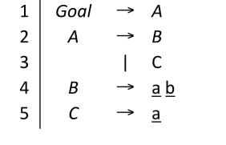
Choosing The Right Handle
Goal
A
Input : ab
C
a
b

Slide 24
Choosing The Right Handle
Goal
A
Input : ab
C
a
b

Slide 25
Stack-based Implementation
Simpler and faster implementation than a tree-based approach
Main idea
  Process one token at a time
    Fits the scanner mode
    Reading all tokens at once does not improve efficiency
    The action of getting the next token is called a shift
  Push token onto stack
    Build frontier incrementally
    Contents of the stack always represents the current frontier
  Look for handle at top of stack
    No need to keep track of k value of the handle
      k is always the top of the stack

Slide 26
Implementation : Shift-reduce Parser
push INVALID
token ← next_token( )
repeat until (top of stack = Goal and token = EOF)
if the top of the stack is a handle A→β
// reduce β to A
pop |β| symbols off the stack
push A onto the stack
else if (token ≠ EOF)
// shift
push token
token ← next_token( )
else // need to shift, but out of input
report an error
How do errors show up?
failure to find a handle
hitting EOF & needing to
shift (final else clause)
Either generates an error

Slide 27
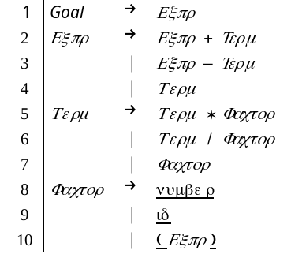
Back to x - 2 * y
1. Shift until the top of the stack is the right end of a handle
2. Find the left end of the handle & reduce

Slide 28
Back to x - 2 * y
Should we reduce Expr?

Slide 29
Back to x - 2 * y
1. Shift until the top of the stack is the right end of a handle
2. Find the left end of the handle & reduce

Slide 30
Back to x - 2 * y
We have two matches! Which rule do we apply?

Slide 31
Back to x - 2 * y
1. Shift until the top of the stack is the right end of a handle
2. Find the left end of the handle & reduce

Slide 32
Back to x – 2 * y
Should we reduce by 5 or 7?

Slide 33
Back to x – 2 * y
5 shifts +
9 reduces + 1 accept

Slide 34
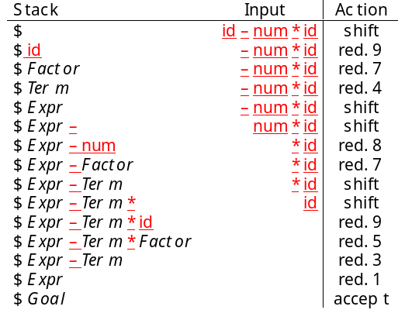
Example
Goal
Expr
Expr
–
Term
Term
Term
*
Fact.
Fact.
Fact.
<id,y>
<id,x>
<num,2>

Slide 35
Shift-reduce Parsing
Shift reduce parsers are easily built and easily understood
A shift-reduce parser has just four actions
Shift — next word is shifted onto the stack
Reduce — right end of handle is at top of stack
  Locate left end of handle within the stack
  Pop handle off stack & push appropriate lhs
Accept — stop parsing & report success
Error — call an error reporting/recovery routine
Accept and Error are simple
Shift is just a push and a call to the scanner
Reduce takes |rhs| pops and 1 push
If handle-finding requires state, put it in the stack ⇒ 2x work
Handle finding is key
handle is on stack
finite set of handles
use a DFA !

Slide 36
LR(1) Parsers
The name LR(1) comes from the following properties
  Scan input Left to right
  Produce a Reverse-rightmost derivation
  Use 1 (one) symbol lookahead
A language is said to be LR(1) if it can be parsed using an LR(1) parser
The LR(1) class is larger than LL(1)

Slide 37
CFG for List
LIST → ( ELEMLIST )
ELEMLIST → ELEM ELEMLIST
| ELEM
ELEM → INT
| LIST

Slide 38
FIRST and FOLLOW
FIRST Sets
    FIRST(ABS) = FIRST(A) = {a}
    FIRST(c) = {c}
    FIRST(ε) = {ε}
    FIRST(a) = {a}
    FIRST(bSb) = {b}
    FIRST(ε) = {ε}
S → ABS
| c
| ε
A → a
B → bSb
| ε

Slide 39
FIRST and FOLLOW
FOLLOW Sets
    FOLLOW(S) = {EOF, b}
    FOLLOW(A) = {a, b, c, EOF}
    FOLLOW(B) = {a, b, c, EOF}
S → ABS
| c
| ε
A → a
B → bSb
| ε

Slide 40
FIRST and FOLLOW
S → ABS
| c
| ε
A → a
B → bSb
| ε
FIRST⁺ Sets
    FIRST⁺(ε) = {ε, EOF, b}
    FIRST⁺(ε) = {ε, a, b, c, EOF}
FIRST(ABS) ∩ FIRST(c) ∩ FIRST⁺(ε)
= {a} ∩ {c} ∩ {ε, b, EOF} OK
FIRST(bSb) ∩ FIRST⁺(ε)
= {b} ∩ {a, b, c, EOF, ε} NOT OK

Slide 41
Left Recursion
P -> Qu -> Pyu
  α = yu
  β₁ = v
  β₂ = zu
  P → vP’
  | zuP’
  P’→ yuP’
  | ε
P → Qu
| v
Q → Py
| z
  Foo → Foo α
  | β
  Foo → β Bar
  Bar → α Bar
  | ε

